Slide 1

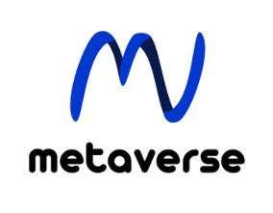


ENHANCING DOCUMENT MANAGEMENT SECURITY
and
Efficiency with Advanced Technological Integration
WORKSHOP
2024 IEEE International Conference on Signal, Image, Video and Communications (ISIVC 2024)
Presented By:
Managed By:
EL Mehdi Ettaki - Big Data Developer
Mouhcin EL youbi - AWS Data Solution Architecture
Mr. Omar Abdeddaim

Slide 2

TABLE OF CONTENT
01
INTRODUCTION
02
CONTEXT Of the PROJECT
03
PROBLEMATIC
04
SOLUTION
05
CONCLUSION
06
APPENDIX
07
DISCUSSION (Q/A)

Slide 3





Context Of the project
Background
Objective
Massive amounts of scanned papers being handled manually and inefficiently.
Develop a system for efficient data extraction, automated categorization, secure data handling, and scalability.
Scope
Stakeholders:
Includes tech implementation, system design, compliance adherence, training, and deployment.
Involves Project Sponsors, IT Department, Operations Team, Compliance Officer,
External Consultants.

Slide 4







Problematic: Enhancing Document Management System Efficiency
Challenges with efficient management, extracting and processing of large-scale, multi-page scanned documents.
Efficient Document Management
Accurate Data Capture
Automation in Data Processing
Ensuring Data Integrity
Data Storage and Security
Access Control and Security
Ensure Scalability and Durability

Slide 5

SOLUTION
Develop an automated system to streamlinefeatures extraction from scanned documents, convertany image-based content into machine-readabletext using OCR(Optical Character Recognition), and then efficiently store the extracted data in a structured sheet format for further analysis and integration with accounting systems.

Slide 6
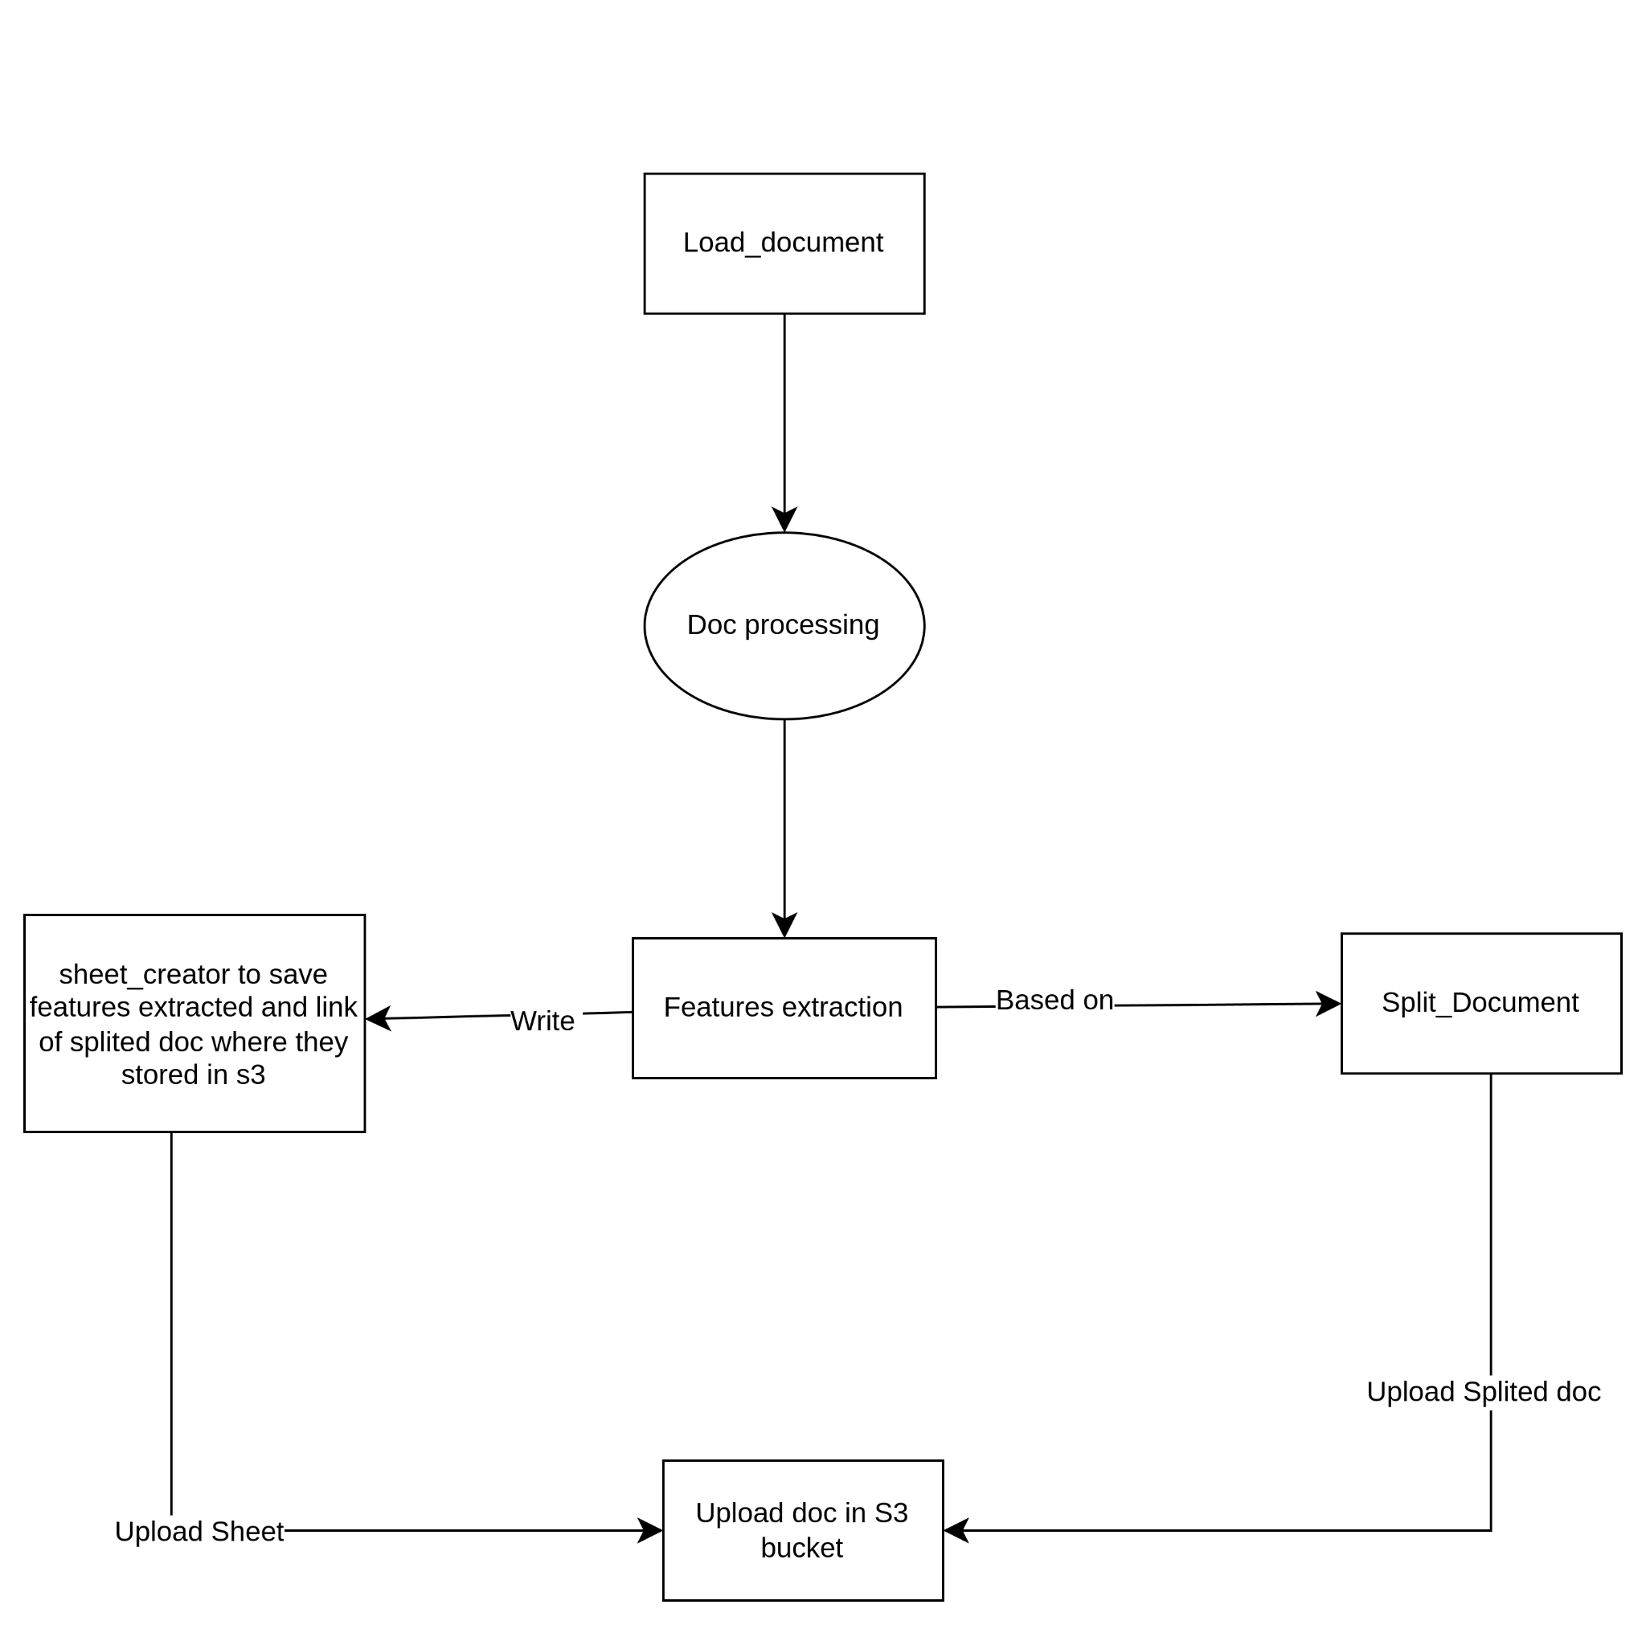
TECHNICAL WORKFLOW
Workflow Of
FEAT-EXT-FORM-DOC

Slide 7
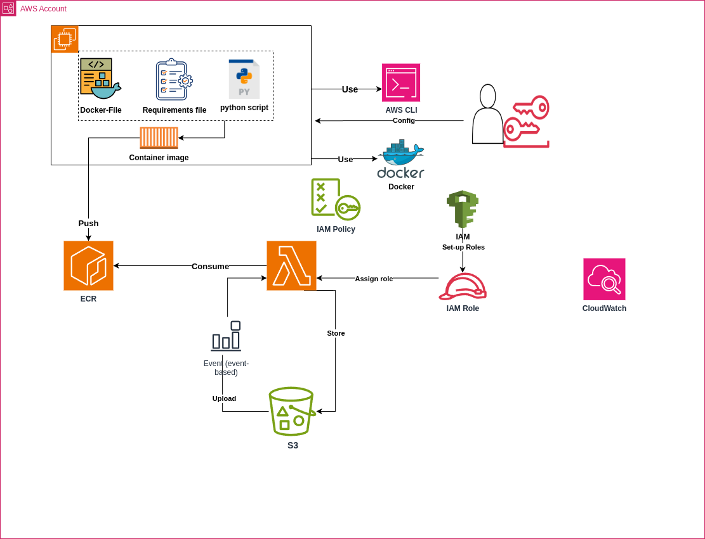
TOOLS AND TECHNOLOGIES
AWS Architecture

Slide 8

AWS SERVICES & TECHNOLOGIES
01
DEFINITION
02
FEATURES
03
HANDS ON

Slide 9
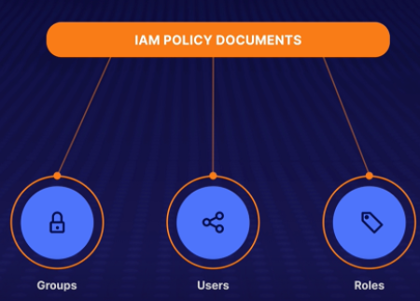

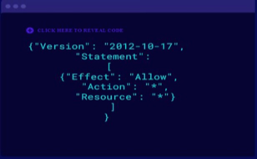
1- IAM DEFINITION:
Manage Users and their level of access to the AWS console.
IAM is universal, not regional.
IAM Policy is a document that defines one or more permissions.

Slide 10
IAM Features:
01
03
MFA
Access Analyzer
IAM
02
04
Policy Management
Password Rotation

Slide 11


Hands On: Let’s Get Our Hands Dirty!
STEP 1:
CREATE IAM USER, POLICY AND ROLE
STEP 2:
GET ACCESS KEYS (GRAMMATICALLY ACCESS)

Slide 12

2- Amazon EC2:
Like a VM that is hosted in AWS instead of your data center.
EC2 Features:
01
03
Optimal storage for every workload
Cost and Capacity Optimization
EC2
02
04
Operating Systems and Software
Other Features
Notes:
3: Pay for What You Use
Optimal storage for every workload
Wait minutes, not months!

Slide 13

TECHNOLOGIES OVERVIEW
3- Python Definition:
Python is one of the most popular programming languages in the world.

Slide 14
Python Features:
Dynamic Typing
Memory Management
Rich library support

Slide 15

4- Docker Definition:
A platform for developing, shipping, and running applications inside software containers.
Notes:
Docker is used to package applications into containers

Slide 16
Docker Features:
Application isolation.
Reduction in size
Notes:
isolation between different applications

Slide 17





Hands On: Let’s Get Our Hands!
Launch an EC2 Instance
Configure the AWS CLI
Generate Docker image
Set up AWS CLI + Python
Write python script & requirement

Slide 18

Hands On: Let’s Get Our Hands!
STEP 2.1: INSTALL AWS CLI USING COMMAND LINE
Update Amazon Linux, replace yum, install AWS CLI:
sudo yum remove awscli
Installation steps:
1.You can get the installation file in one of the following ways:
curl "https://awscli.amazonaws.com/awscli-exe-linux-x86_64.zip" -o "awscliv2.zip"
1.Unzip the installer:unzip -u awscliv2.zip
2.Run the install program: sudo ./aws/install
STEP 2.2: CONFIGURE THE AWS CLI
USING AWS CONFIGURE
The following example sets up a profile named workshop_userwith sample values:
aws configure --profile workshop_user

Slide 19
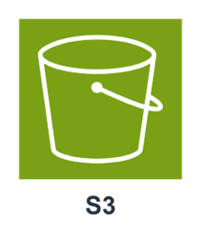
7- Amazon S3:
Object-Based storage allows you to upload files (png,pdf,mp4,...).

Slide 20
S3 Features:
01
03
Highly availability
Highly Durability
S3
02
04
Automatically Scalling
Secure
Notes:
Availability refers to the ability to access your data when you need it.
you can trust that your data will not be lost or corrupted, ensuring long-term data integrity
his means that if you store 100 billion objects in S3, you will lose one object at most

Slide 21
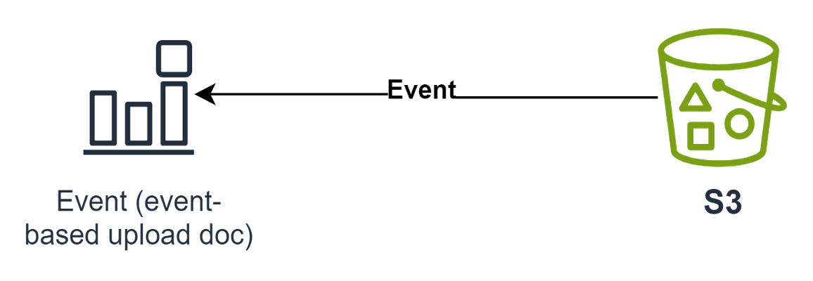
Hands On: Let’s Get Our Hands Dirty!

Slide 22

5- Amazon ECR:
Fully managed Docker container registry that makes it easy to store, share, and deploy container images.

Slide 23
ECR Features:
01
03
Private Registries
Image Scanning
ECR
02
04
Resource-Based Permissions
Image Scanning With Scan on Push

Slide 24

6- AWS Lambda Function:
Serverless computing service.
It allows you to run code without provisioning or managing servers.

Slide 25
Lambda Features:
01
03
Serverless Computing
Scalability
Lambda
02
04
Event-driven
Security

Slide 26
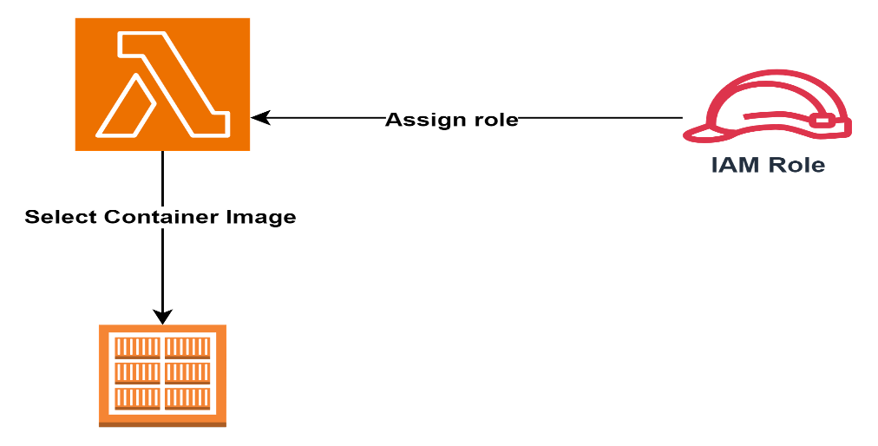
Hands On: Let’s Get Our Hands On!

Slide 27

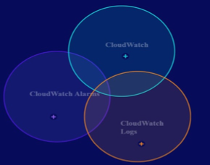
8- Amazon CloudWatch:
All about monitoring the performance and health of your systems.

Slide 28
CloudWatch Features:
01
03
Cross-account Observability
Alarms and Automated Actions
CloudWatch
02
04
Metric Streams
Logs and Log Insights

Slide 29
RESULTS AND METRICS

Slide 30


PERFORMANCE METRICS
Document retrieval time was reduced by 60%
Security incidents involving document access were decreased by 80%.

Slide 31
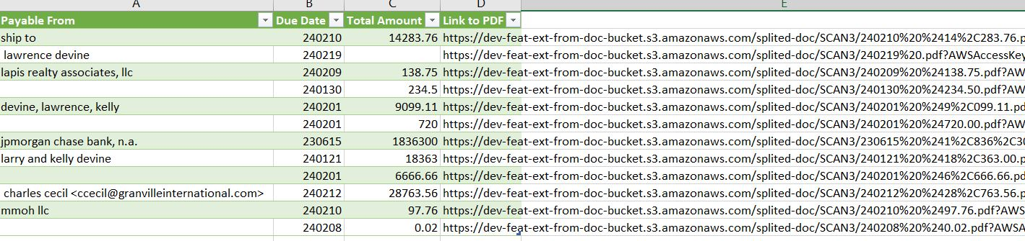
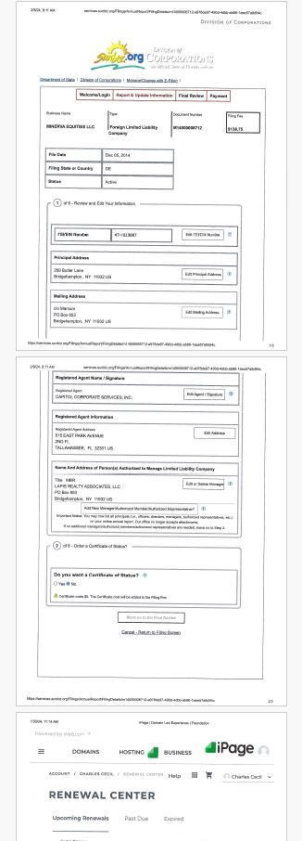
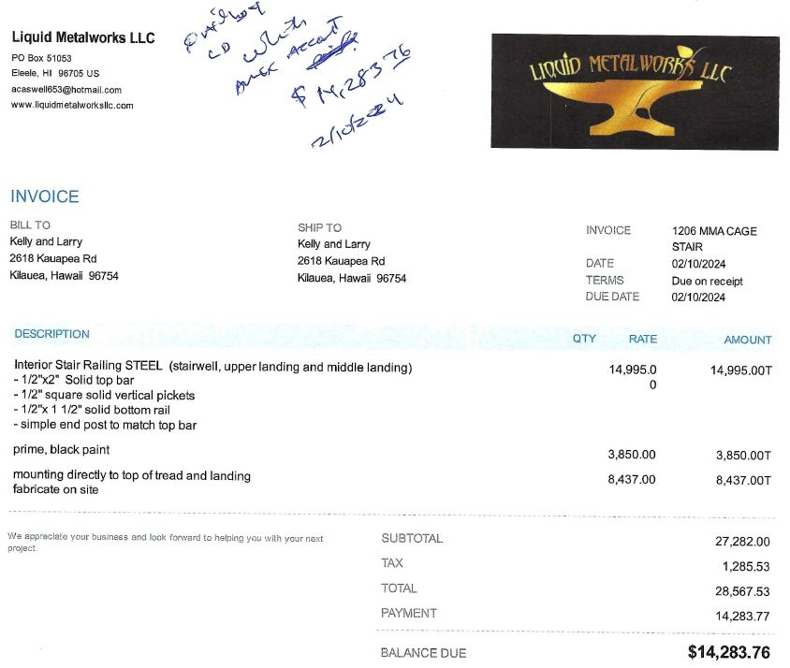
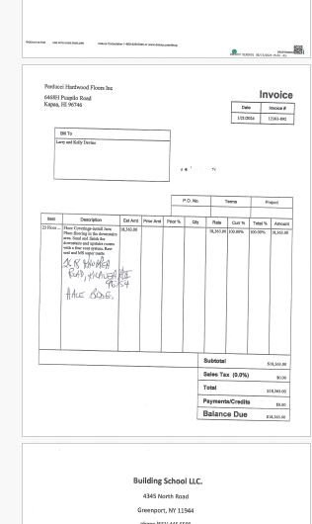
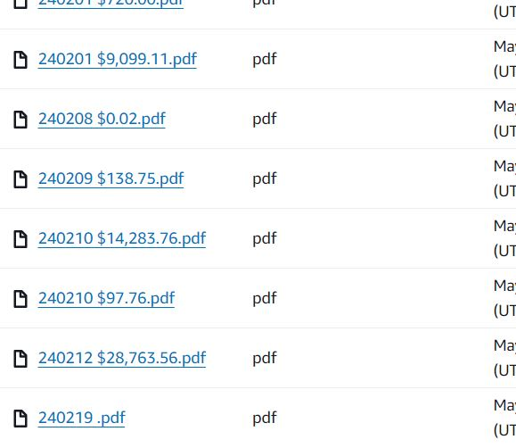
CASE STUDIES

Slide 32
CONCLUSION

Slide 33
APPENDIX
Aws-cli installation
Aws-cli Authentication
Installing Docker to use with the AWS SAM CLI
Git Installation
Lambda function
Amazon S3
Amazon Elastic Container Registry (Amazon ECR)
AWS Identity and Access Management (IAM)
Amazon CloudWatch
Amazon Elastic Compute Cloud
AWS SDK PYTHON
Amazon Textract
Generating a new SSH key and adding it to the ssh-agent
Amazon Linux 2 based on RHEL
Notes:
https:/docs.aws.amazon.com/cli/latest/userguide/cli-authentication-user.html

Slide 34
Q/A
Q1. How to intercat from on-premise (app external from aws) to access aws services?
A1: Use AWS SDK (There are aws sdk for python , java, ....)
Q2: Is it possible to use a single key pair to manage multiple Amazon EC2 instances ?
A2: Yes, it is possible to use one key pair to interact with multiple EC2 instances in Development & Test environments.However it’s not recommended in a production environment due to security risks.
Q3: If we have a document that takes more than 15 minutes to process inside a lambda function, Which AWS services can we use ?
A3: There are several methods you can use, such as AWS Batch, AWS Step Function, …
Q4: Amazon Linux 2 based on which OS distribution ?
A4: Amazon Linux 2 is based on Red Hat Enterprise Linux (RHEL)
Q5: Is it possible to interact with Amazon EC2 from my local machine ?
A5: Yes, you can interact with EC2 from your local machine by add key pair to your local machine by the cmd bellow :
sudo ssh -i Downloads/"key-pair.pem" ec2-user@ec2-100-26-31-215.compute-1.a

